Slide 2
Math Fact Fluency
Extensive research has demonstrated the critical role of fact fluency in elementary school level mathematics and beyond (e.g., Isaacs & Carroll, 1999; Kail & Hall, 1997; Miller & Heyward, 1992; Royer et al, 1999; Woodward, 2006; Zentall 1990).

Slide 3
Effective Fluency:
Learning new math facts in a way that facilitates progress to memory-base retrieval.
Strengthening the association of the fact in memory to make retrieval automatic.

Slide 4
Components of Reflex®
1. Covers complete process of fact mastery, from initial acquisition of previously unknown facts through automaticity.
2. Continuously differentiates instruction and adapts practice to each student’s current ability and needs, throughout the entire session.

Slide 5
Components of Reflex®
3. Generates a fun, motivational environment for students, one that encourages frequent use and reinforces the connect between effort and success in mathematics.
4. Provides educators with intuitive, insightful reports to monitor fluency gains and system usage.

Slide 7
Acquisition to Automaticity
a) systematic introduction of small sets of new facts using appropriate strategies;
b) development of the student’s preliminary ability to recall these new facts from memory;
c) progression to timed retrieval once the student has demonstrated readiness;
d) automatization through game-based practice, wherein facts are recalled while the student’s working memory is increasingly loaded with game-based tasks

Slide 8
Systematic introduction of small sets of new facts using appropriate strategies
Notes:
During initial stages, student received introductory lessons on strategies

Slide 10
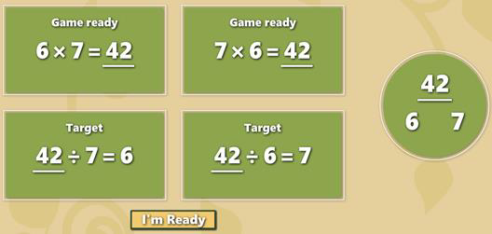
Notes:
Once students are ready to begin using a given strategy, they will progress to the first stage of acquisition practice. They must recall both the known and new facts from memory and type them in.

Slide 11
Notes:
Progressively developing and strengthening the student’s ability to recall new facts.

Slide 12
Notes:
Practice with moderate time pressure and increasing retrieval difficulty. Students need to first do two picture puzzles before they can progress to the game.
Coach Penny’s Picture Puzzle marks the stage where speed of retrieval is first introduced as a performance requirement. During this stage, Reflex continuously adjusts the difficulty of the retrieval process based on the student’s responses. For example, the interval between administrations of a given fact may increase or decrease, and the types of facts that are used in between administrations of that fact may be changed.

Slide 13
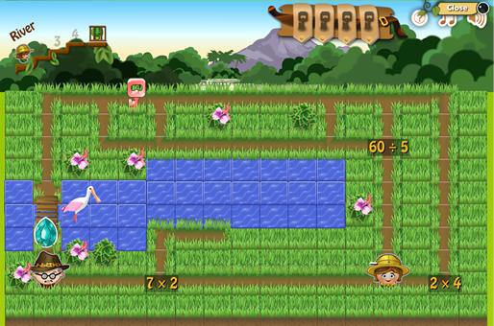
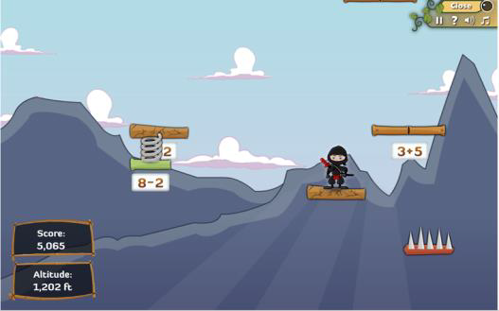
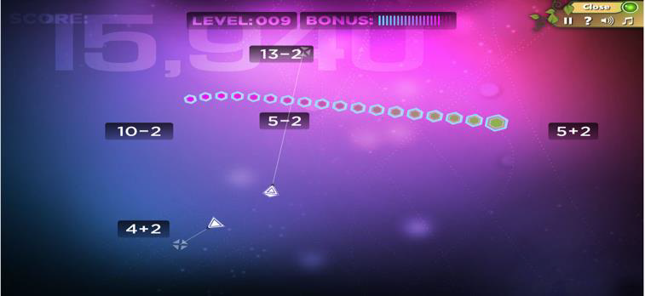
Notes:
Game-based practice. Students begin with access to two games and every six days of practice

Slide 14
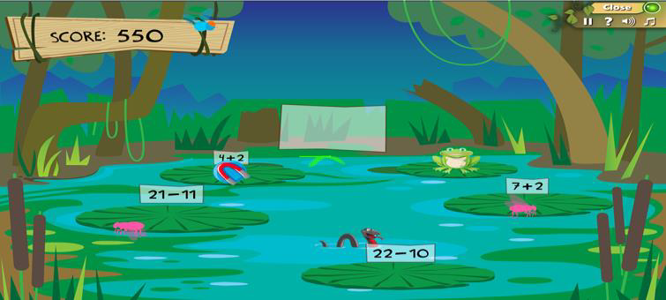
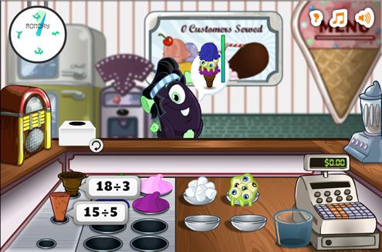

Slide 15
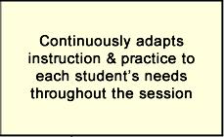
Adapting instruction and practice for optimal results
Accurate measurement of fact retrieval speed by factoring out typing ability.
Selecting new facts to learn, and the optimal strategy to use to learn them.
Matching the pace of learning to the student’s demonstrated abilities.
Optimizing practice.
Assessing fluency.

Slide 16
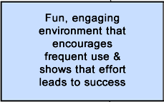
Recognizing Effort & Accomplishments
Individualized progression
Visible, continuous growth in fluency
Recognition of effort as well as progress

Slide 18
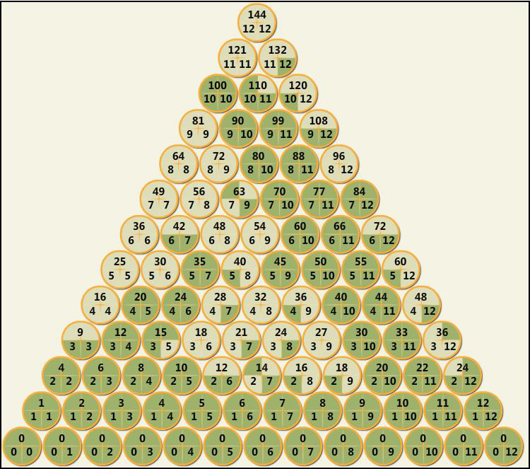
Notes:
Reports

Slide 19
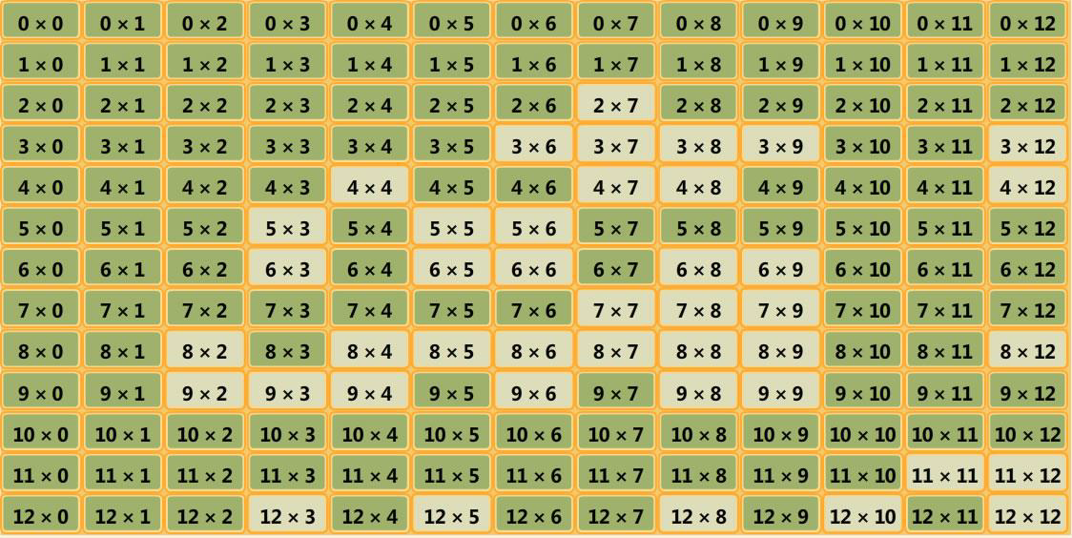

Slide 20
Store & Avatar

Slide 21
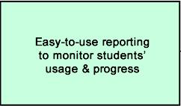
Monitoring Progress
“Dashboard” - overviews of key information on usage and progress, as well as alerts.
Summary & detailed data on current fluency levels and daily fluency growth for individuals and groups.
Displays that relate Reflex usage to fluency gains.

Slide 22
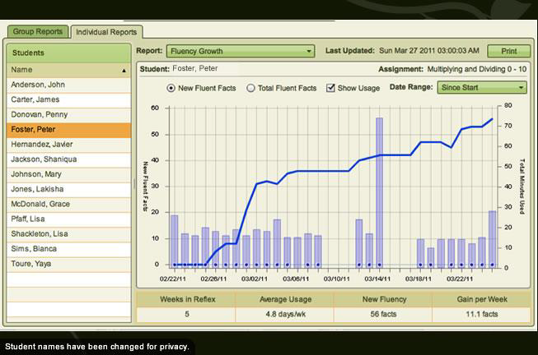

Slide 23
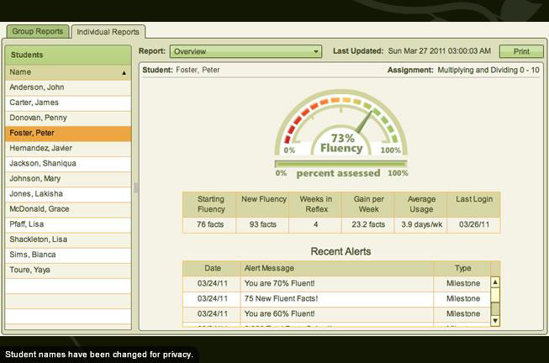

Slide 27
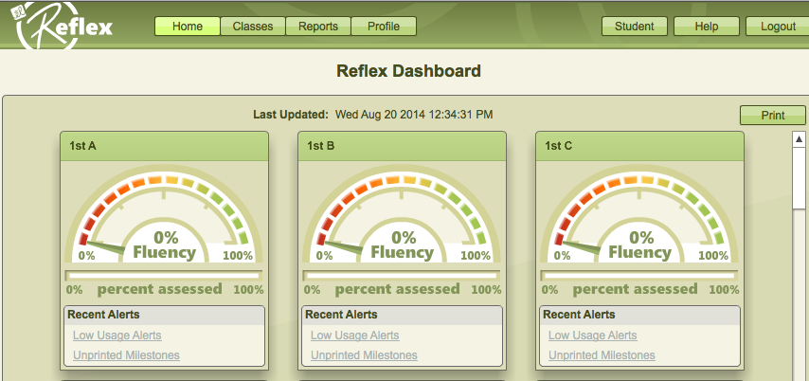

Slide 30
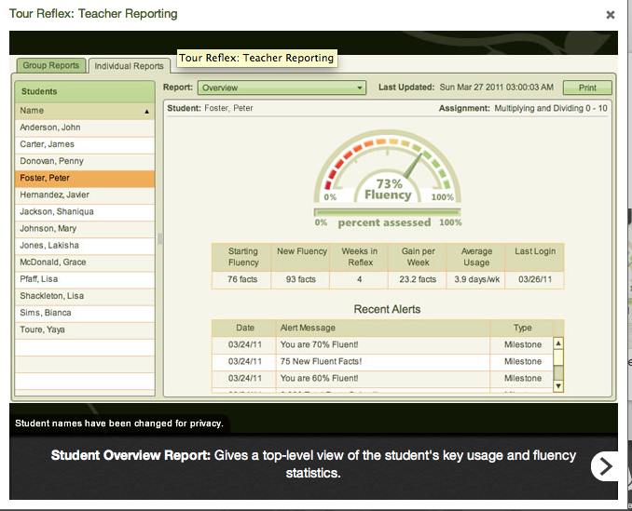

Slide 31
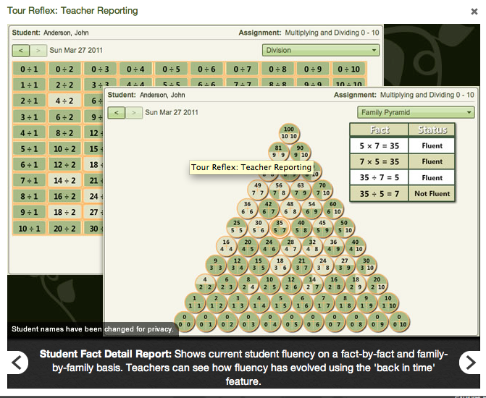

Slide 32
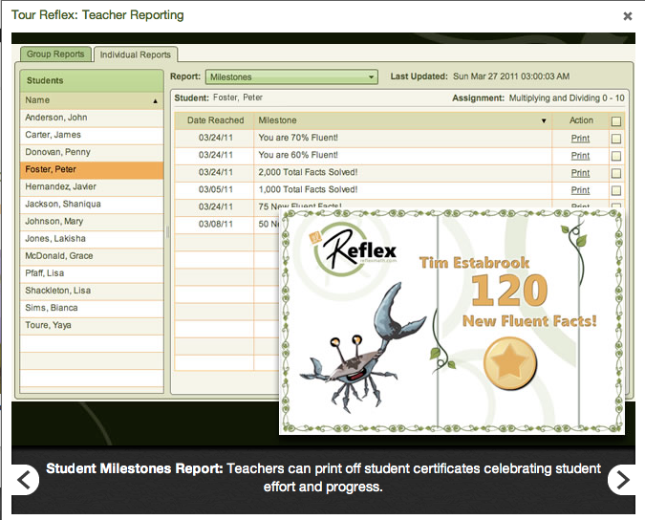

Slide 33
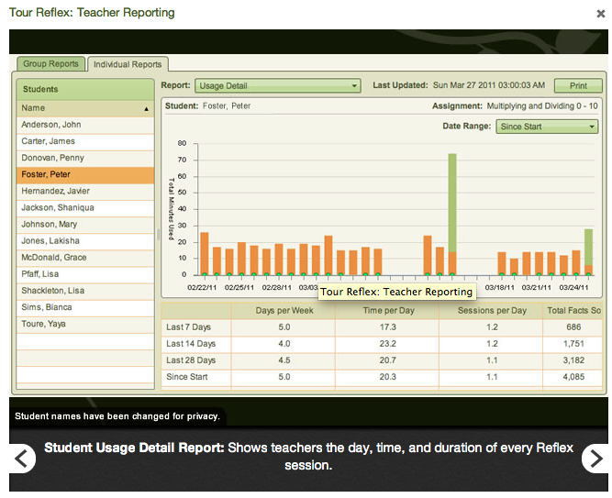

Slide 34
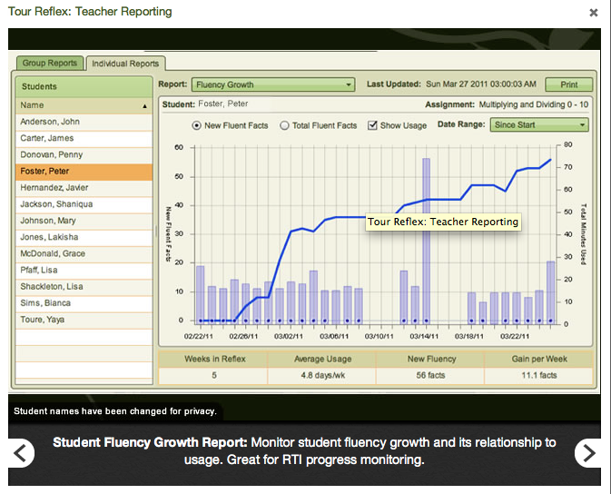

Slide 35
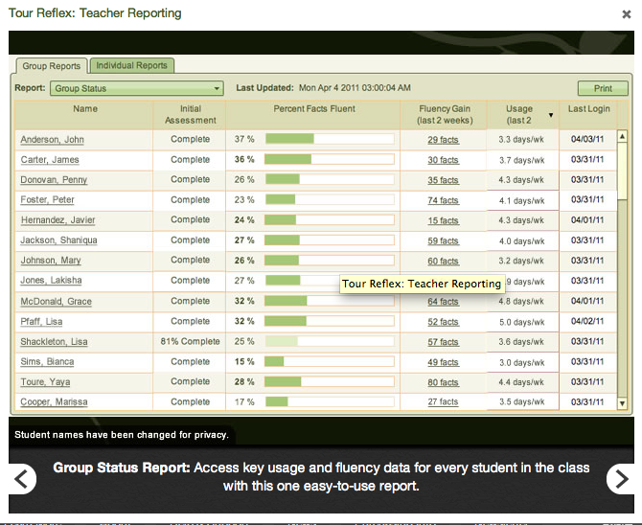

Slide 36
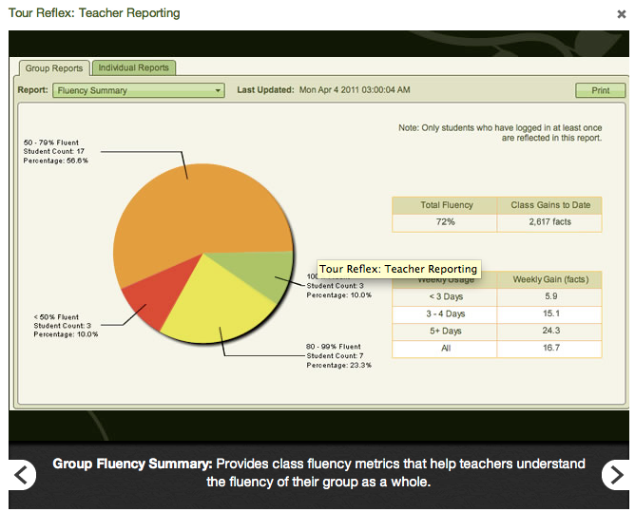

Slide 37
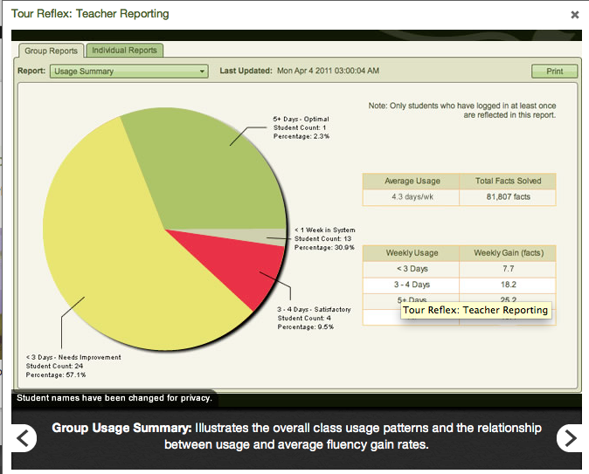

Slide 39
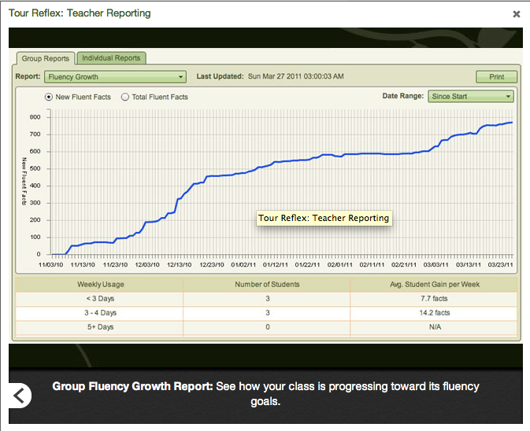

Slide 42
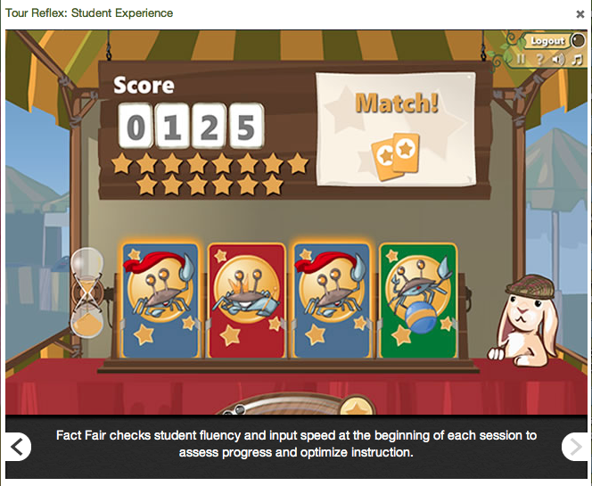

Slide 43
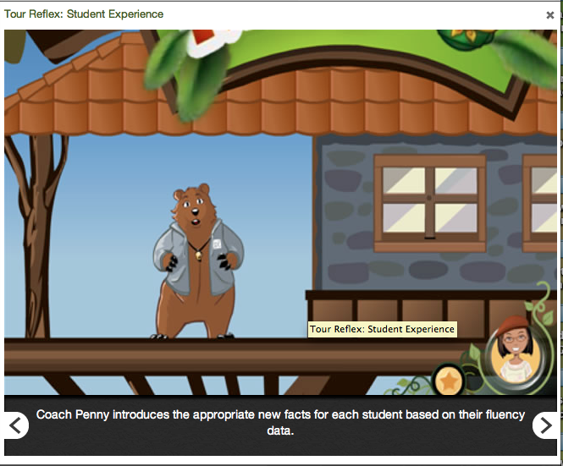

Slide 46
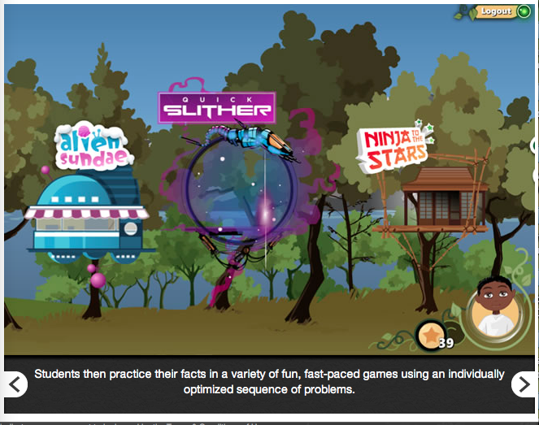

Slide 47
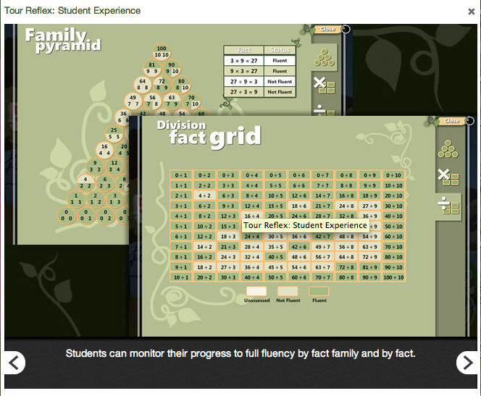

Slide 50
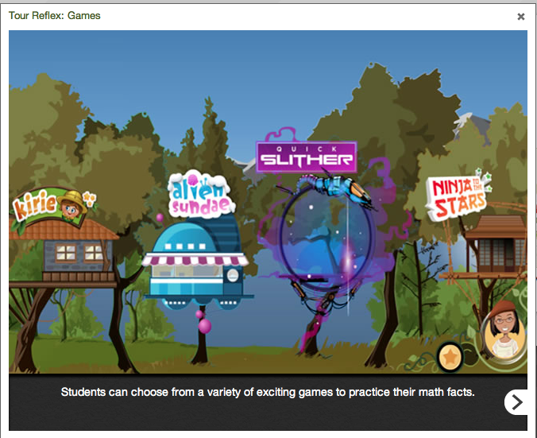

Slide 51
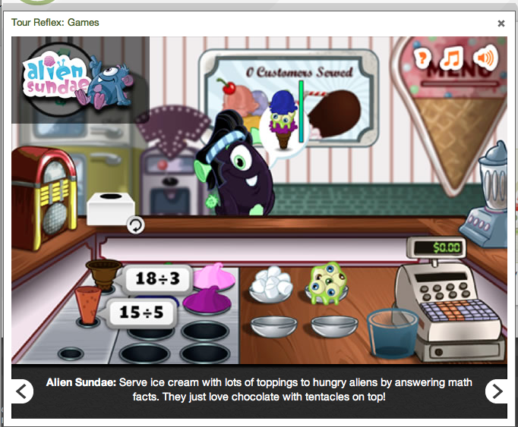

Slide 53
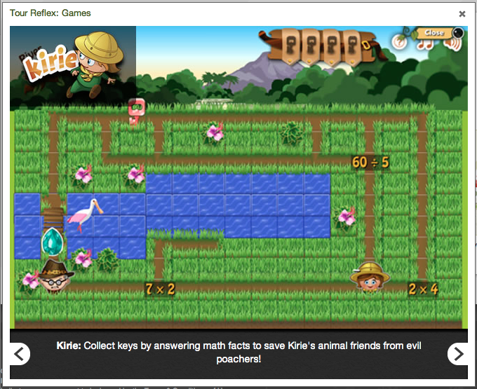

Slide 54
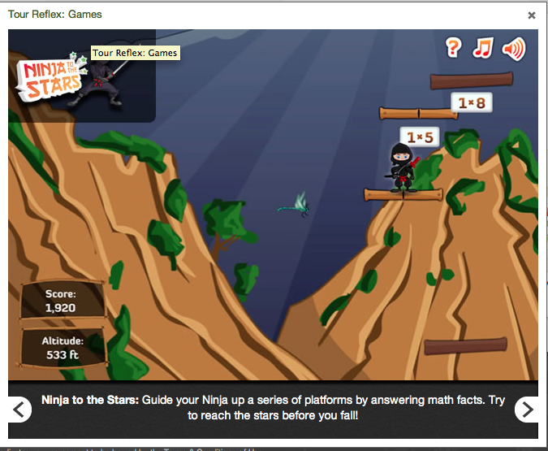

Slide 55
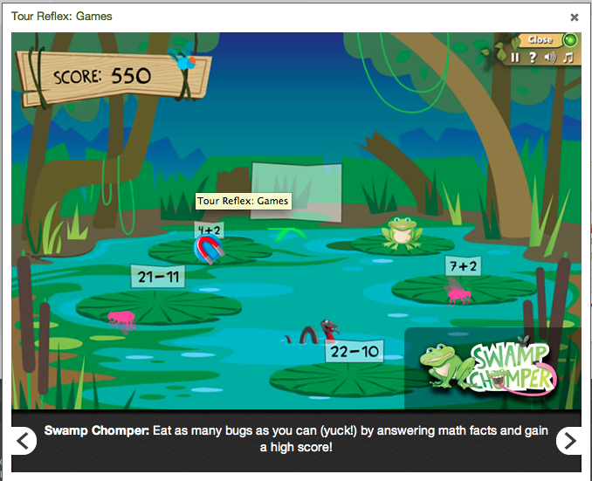

Slide 56
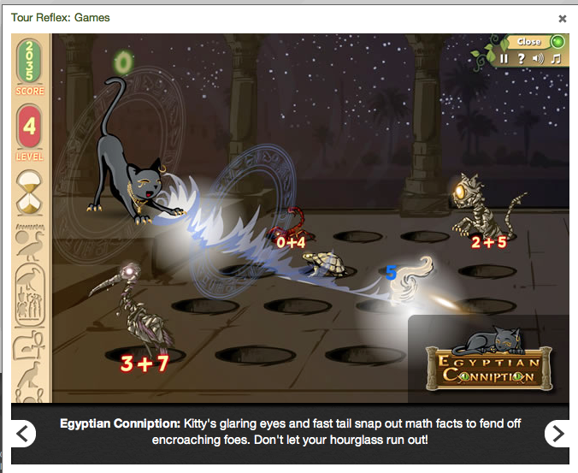

Slide 57
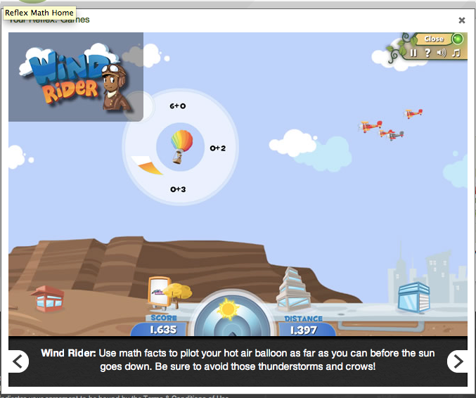

Slide 58
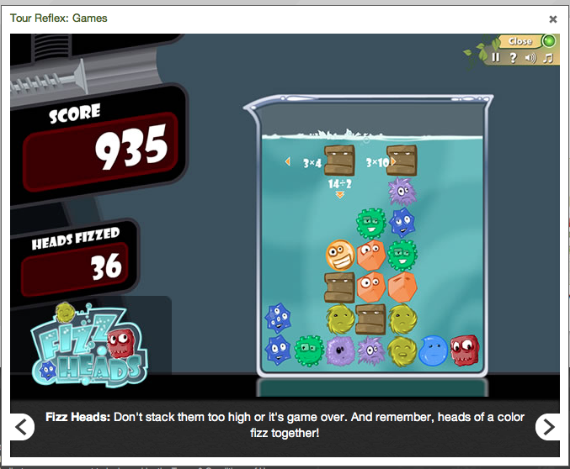

Slide 59
